Slide 1






Foundations of
Quantum Computing
(QIS 301)
Dave Biersach
Brookhaven National Laboratory
dbiersach@bnl.gov
Session 10
Complex Algebra

Slide 2
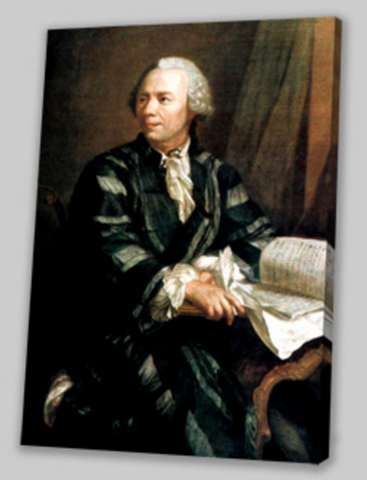
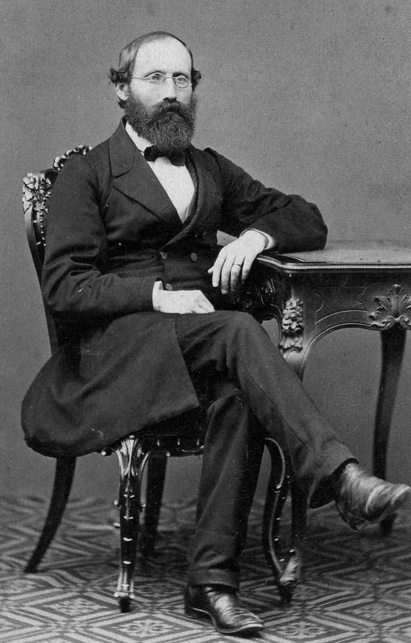
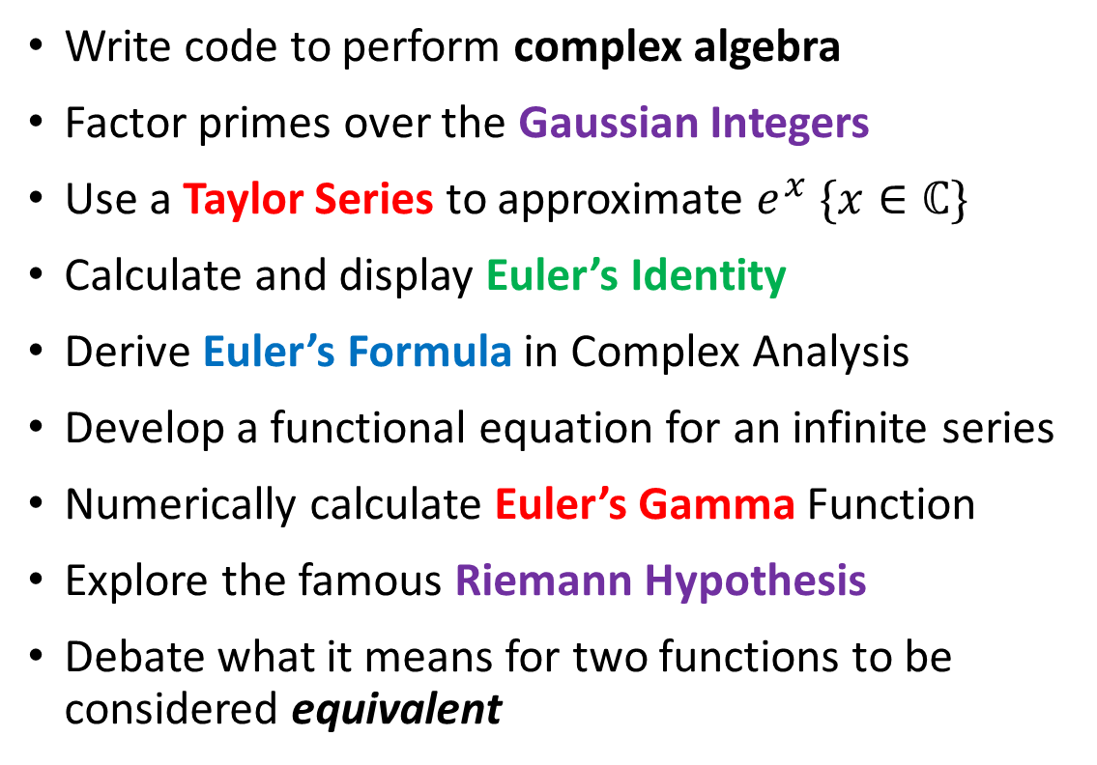
Section Goals
Write code to perform complex algebra
Factor primes over the Gaussian Integers
Use a Taylor Series to approximate $e^{x} \{x∈ℂ\}$
Calculate and display Euler’s Identity
Derive Euler’s Formula in Complex Analysis
Develop a functional equation for an infinite series
Numerically calculate Euler’s Gamma Function
Explore the famous Riemann Hypothesis
Debate what it means for two functions to be considered equivalent

Slide 3
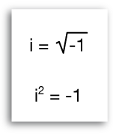
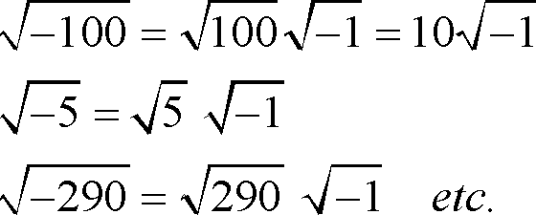
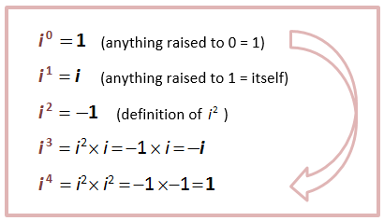
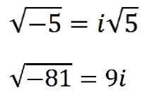
Complex Numbers

Slide 4
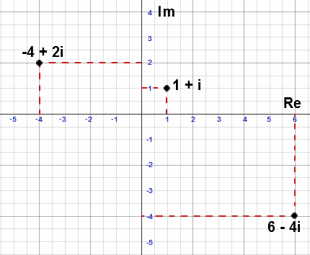
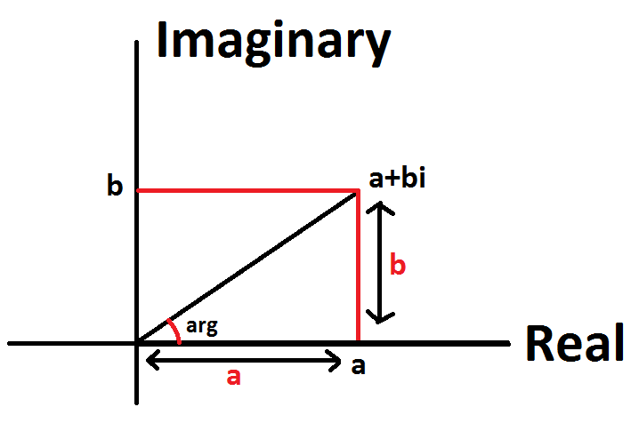
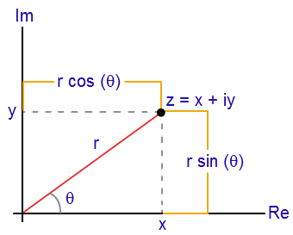
Complex Numbers

Slide 5
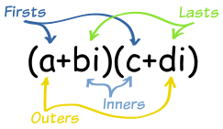
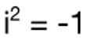
Complex Algebra
Sum:
$$\left(4+3i\right)+\left(5−4i\right)=\left(4+5\right)+\left(3−4\right)i$$
$$=9−i$$
Difference:
$$\left(4+3i\right)−\left(5−4i\right)=\left(4−5\right)+\left(3−\left(−4\right)\right)i$$
$$=−1+7i$$
Product:
$$\left(4+3i\right)\left(5−4i\right)=20−16i+15i−12i^{2}$$
$$=20−i+12$$
$$=32−i$$

Slide 6
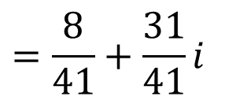
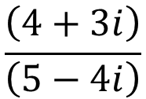
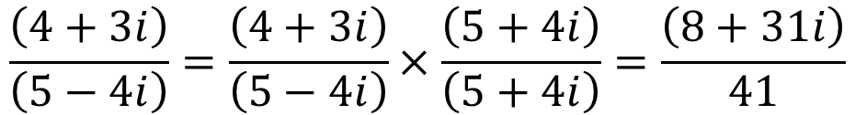
Complex Algebra
Division:
$$\frac{\left(4+3i\right)}{\left(5−4i\right)}$$
$$\frac{\left(4+3i\right)}{\left(5−4i\right)}=\frac{\left(4+3i\right)}{\left(5−4i\right)}×\frac{\left(5+4i\right)}{\left(5+4i\right)}=\frac{\left(8+31i\right)}{41}$$
Complex Conjugate
$$=\frac{8}{41}+\frac{31}{41}i$$

Slide 7
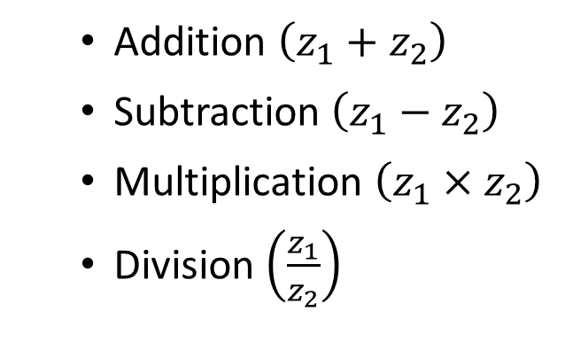

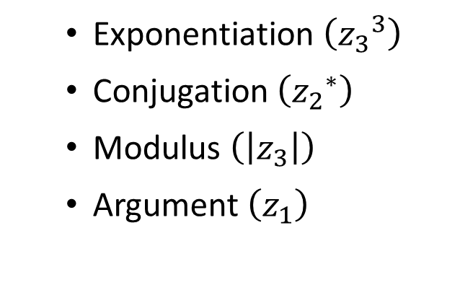
Open complex_algebra.py
Given $z_{1}, z_{2}{,z}_{3}∈ℂ$
write Python code to display:
Addition $\left(z_{1}+z_{2}\right)$
Subtraction $\left(z_{1}−z_{2}\right)$
Multiplication $\left(z_{1}×z_{2}\right)$
Division $\left(\frac{z_{1}}{z_{2}}\right)$
Exponentiation $\left({z_{3}}^{3}\right)$
Conjugation $\left({z_{2}}^{∗}\right)$
Modulus $\left(\left|z_{3}\right|\right)$
Argument $\left(z_{1}\right)$

Slide 8
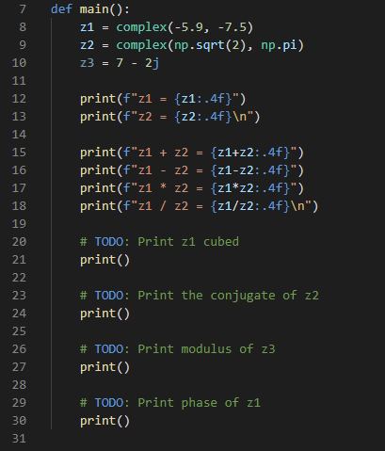

Edit complex_algebra.py
①
②
③
④
⑤
⑥
⑦
⑧

Slide 9


Edit complex_algebra.py

Slide 10
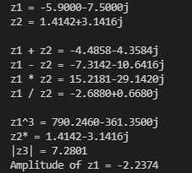
Run complex_algebra.py

Slide 11
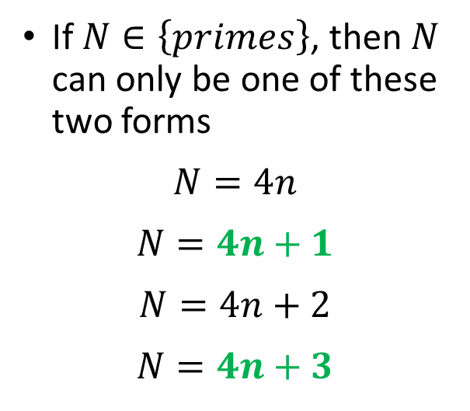

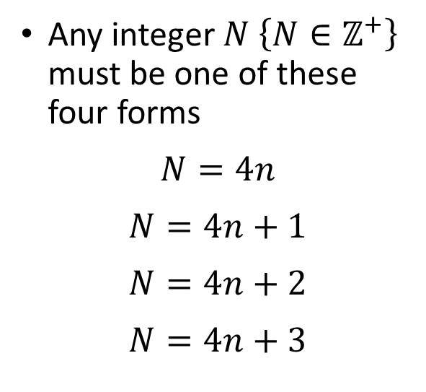
Representation Theory
Any integer $N \left\{N∈ℤ^{+}\right\}$ must be one of these four forms
$$N=4n$$
$$N=4n+1$$
$$N=4n+2$$
$$N=4n+3$$
If $N∈\left\{primes\right\}$, then $N$ can only be one of these two forms
$$N=4n$$
$$N=4n+1$$
$$N=4n+2$$
$$N=4n+3$$
$$N prime⇒N \% 4=\left\{1, 3\right\}$$

Slide 12
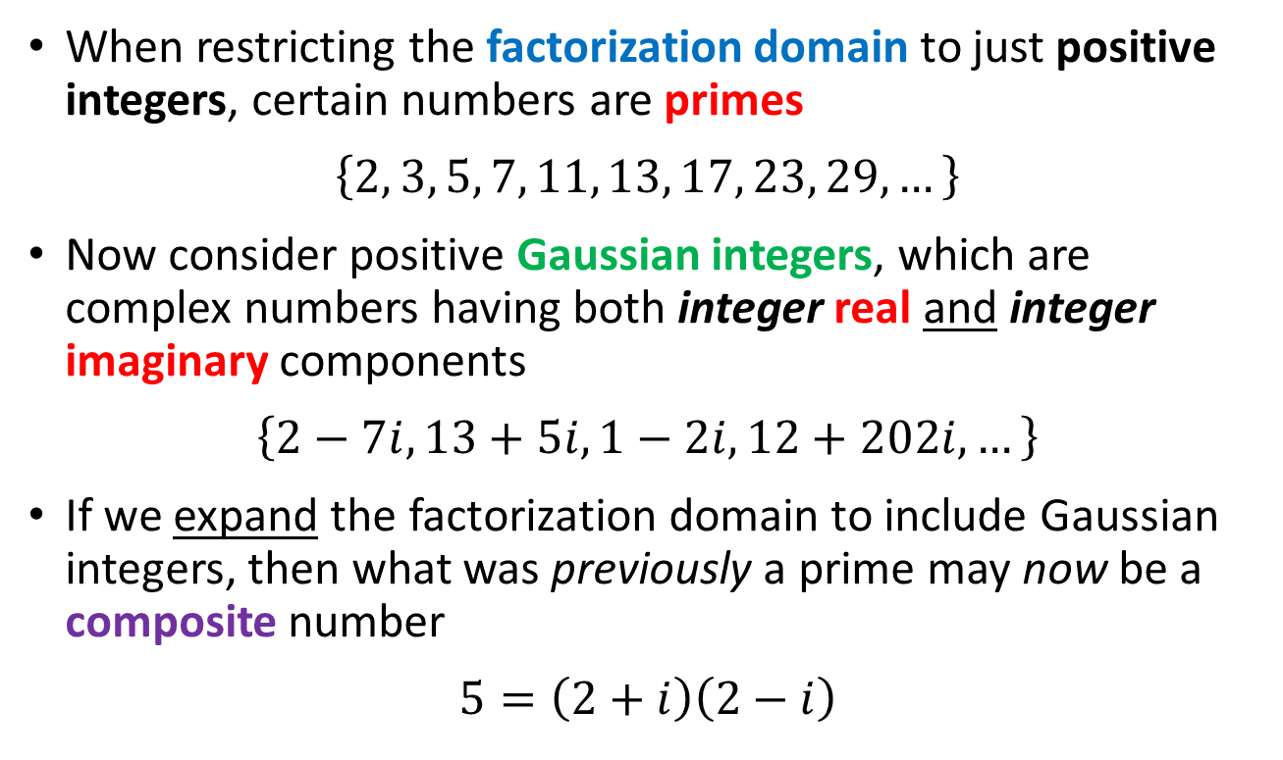
Unique Factorization Domains
When restricting the factorization domain to just positive integers, certain numbers are primes
$$\left\{2, 3, 5, 7, 11, 13, 17, 23, 29,…\right\}$$
Now consider positive Gaussian integers, which are complex numbers having both integer real and integer imaginary components
$$\left\{2−7i, 13+5i, 1−2i, 12+202i, …\right\}$$
If we expand the factorization domain to include Gaussian integers, then what was previously a prime may now be a composite number
$$5=\left(2+i\right)\left(2−i\right)$$

Slide 13
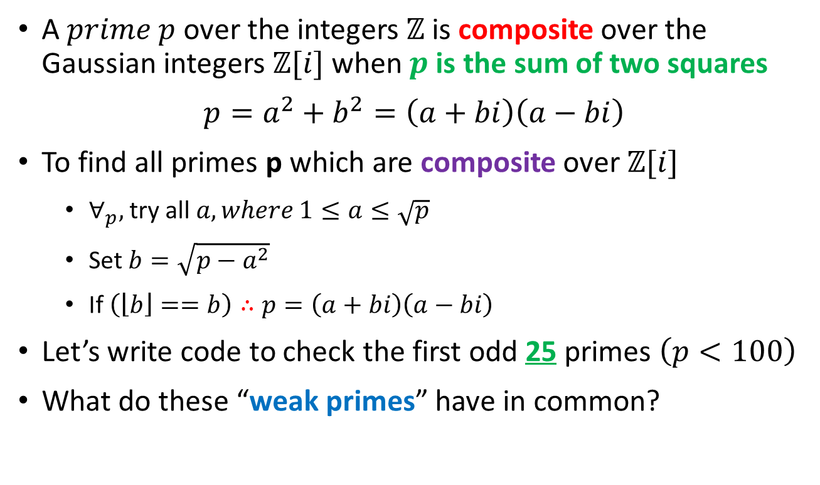
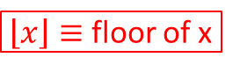
Unique Factorization Domains
A $prime p$over the integers $ℤ$is composite over the Gaussian integers $ℤ[i]$ when $p$ is the sum of two squares
$$p=a^{2}+b^{2}=\left(a+bi\right)\left(a−bi\right)$$
To find all primes p which are composite over $ℤ[i]$
$∀_{p},$ try all $a,where 1≤a≤\sqrt{p}$
Set $b=\sqrt{p−a^{2}}$
If $\left(\left\lfloor b\right\rfloor ==b\right)∴p=\left(a+bi\right)\left(a−bi\right)$
Let’s write code to check the first odd 25 primes $\left(p<100\right)$
What do these “weak primes” have in common?
$\left\lfloor x\right\rfloor ≡$ floor of x

Slide 14
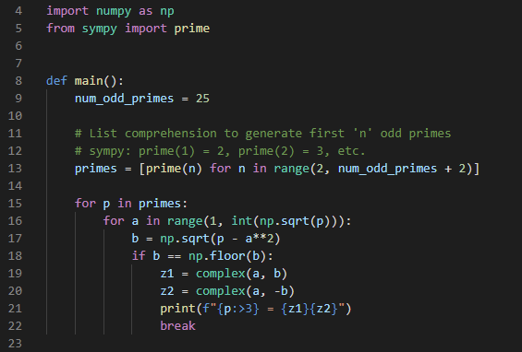
Open complex_factorization.py
①
②
③
④
⑤
⑥
⑦
⑧

Slide 15
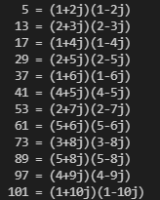
Run complex_factorization.py
What do these 11 primes have in common?
Hint: see slide #11

Slide 16
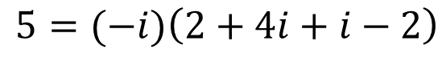
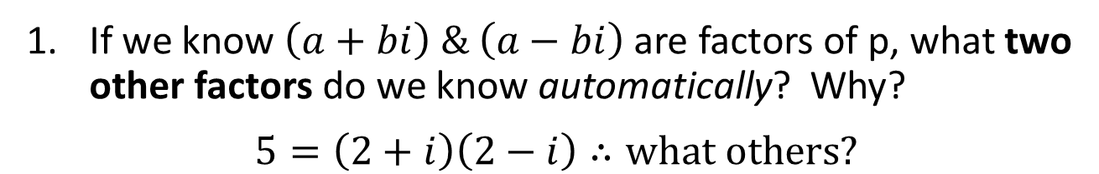
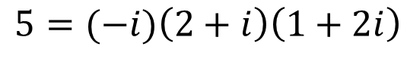
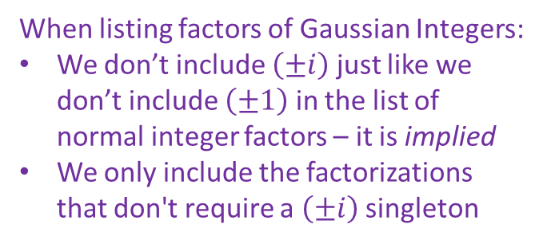
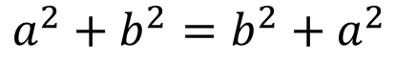

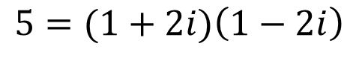

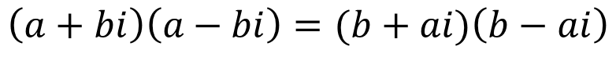
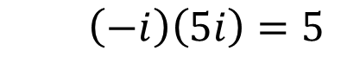
Research Questions
If we know $\left(a+bi\right) \& \left(a−bi\right)$ are factors of p, what two other factors do we know automatically? Why?
$$5=\left(2+i\right)\left(2−i\right)∴what others?$$
$$a=2$$
$$\left(a+bi\right)\left(a−bi\right)=(b+ai)\left(b−ai\right)$$
$$b=1$$
$$a^{2}+b^{2}=b^{2}+a^{2}$$
$$5=(1+2i)\left(1−2i\right)$$
When listing factors of Gaussian Integers:
We don’t include $\left(±i\right)$ just like we don’t include $\left(±1\right)$ in the list of normal integer factors – it is implied
We only include the factorizations that don't require a $\left(±i\right)$ singleton
$$5=(−i)\left(2+i\right)\left(1+2i\right)$$
$$5=(−i)\left(2+4i+i−2\right)$$
$$\left(−i\right)\left(5i\right)=5$$

Slide 17
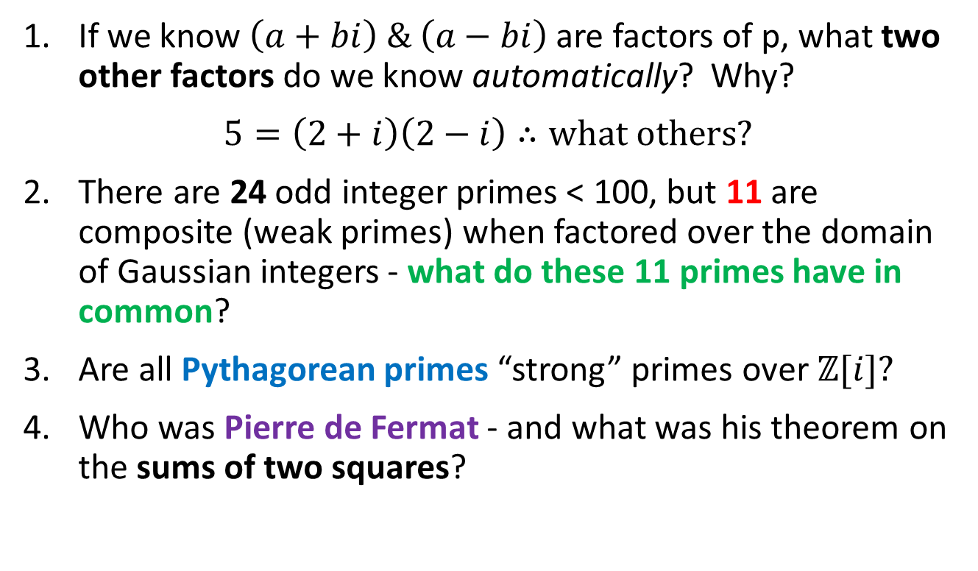
Research Questions
If we know $\left(a+bi\right) \& \left(a−bi\right)$ are factors of p, what two other factors do we know automatically? Why?
$$5=\left(2+i\right)\left(2−i\right)∴what others?$$
There are 24 odd integer primes < 100, but 11 are composite (weak primes) when factored over the domain of Gaussian integers - what do these 11 primes have in common?
Are all Pythagorean primes “strong” primes over $ℤ[i]?$
Who was Pierre de Fermat - and what was his theorem on the sums of two squares?

Slide 18
Why is $e$ so special?
Take an item of size $n$ and divide it into $m$ parts
$∴$ the size of each part $p$ $=\frac{n}{m}$
Q: What value of $m$ maximizes $p^{m}$ ?
A: When $m=e$
$$e=\sum_{n=0}^{∞}{\frac{1}{n!}=\frac{1}{1}+\frac{1}{1}+\frac{1}{2}+\frac{1}{6}+\frac{1}{24}+…}$$
$$e=\lim_{n→∞}{{\left(1+\frac{1}{n}\right)}^{n}}$$
$e$ is the base of the natural logarithm
= 2.718281828459045…
$$\int_{1}^{e}{\frac{1}{t}ⅆt=1}$$
$$\ln{e}=1$$

Slide 19
Why is $e$ so special?
$c≡$ a constant
$${ce}^{x}=c+cx+\frac{cx^{2}}{2!}+\frac{cx^{3}}{3!}+\frac{cx^{4}}{4!}+\frac{cx^{5}}{5!}+\frac{cx^{6}}{6!}+\frac{cx^{7}}{7!}+…$$
$\frac{d}{dx}\left(ce^{x}\right)=\frac{d}{dx}\left(c\right)+\frac{d}{dx}\left(cx\right)+\frac{d}{dx}\left(\frac{{cx}^{2}}{2!}\right)+\frac{d}{dx}\left(\frac{{cx}^{3}}{3!}\right)+…$
$$\frac{d}{dx}\left({ce}^{x}\right)=0+c+cx+\frac{cx^{2}}{2!}+\frac{x^{3}}{3!}+\frac{x^{4}}{4!}+\frac{x^{5}}{5!}+\frac{x^{6}}{6!}+\frac{x^{7}}{7!}+…$$
$$\frac{d}{dx}\left(ce^{x}\right)={ce}^{x}$$
${ce}^{x}$is the only function which is the derivative of itself !

Slide 20
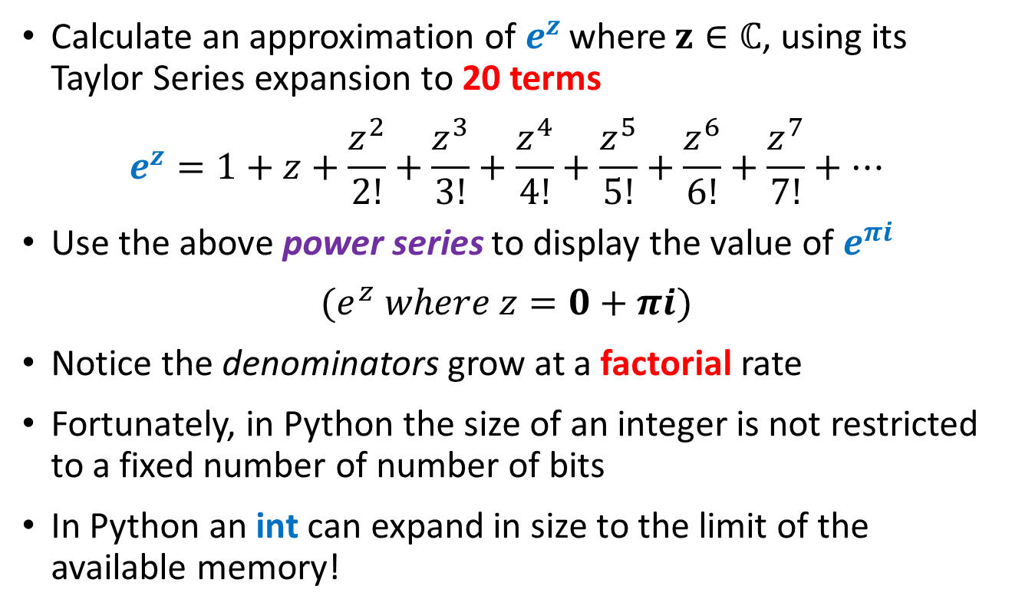
Euler’s Identity
Calculate an approximation of $e^{z}$ where $z∈ℂ$, using its Taylor Series expansion to 20 terms
$$e^{z}=1+z+\frac{z^{2}}{2!}+\frac{z^{3}}{3!}+\frac{z^{4}}{4!}+\frac{z^{5}}{5!}+\frac{z^{6}}{6!}+\frac{z^{7}}{7!}+…$$
Use the above power series to display the value of $e^{πi}$
$$(e^{z} where z=0+πi)$$
Notice the denominators grow at a factorial rate
Fortunately, in Python the size of an integer is not restricted to a fixed number of number of bits
In Python an int can expand in size to the limit of the available memory!

Slide 21
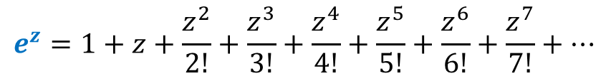
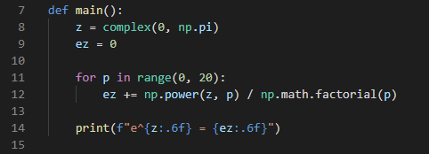

Open euler_identity.py
$$z=πi$$

Slide 22
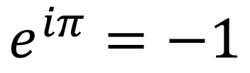
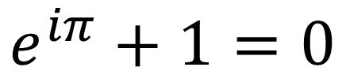
Run euler_identity.py
$$e^{iπ}=−1$$
$$e^{iπ}+1=0$$

Slide 23
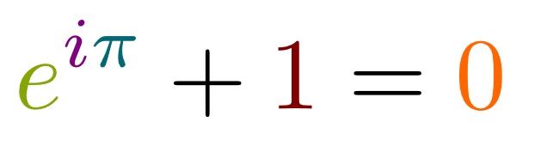
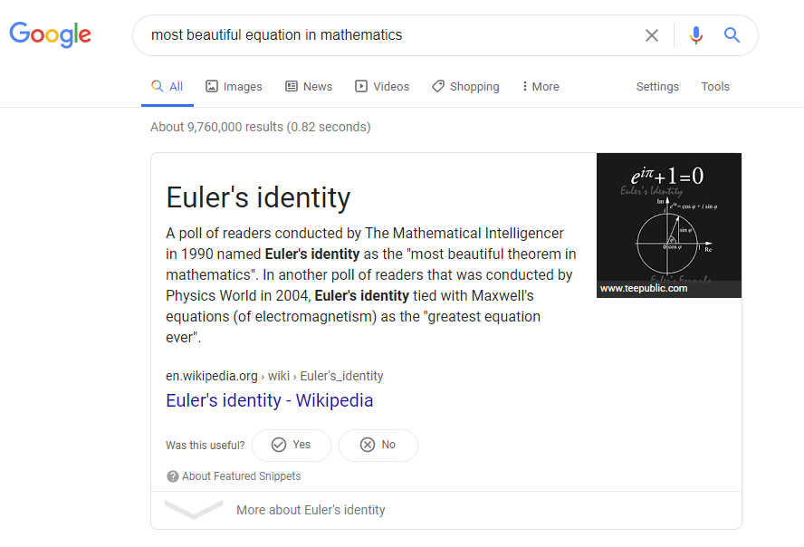
Euler’s Identity

Slide 24
$$−1=e^{πi}$$
$$i^{i}= ?$$
$${\left(−1\right)}^{\frac{1}{2}}={\left(e^{πi}\right)}^{\frac{1}{2}}$$
$$\sqrt{−1}=e^{\frac{πi}{2}}$$
$${\left(a^{b}\right)}^{c}=a^{bc}$$
$${\left(2^{3}\right)}^{4}=2^{3×4}=2^{12}$$
$$i=e^{\frac{πi}{2}}$$
$$i^{i}={\left(e^{\frac{πi}{2}}\right)}^{i}$$
$$e^{πi}=−1$$
$$i^{i}=e^{\frac{πi^{2}}{2}}$$
$$i^{i}=e^{\frac{−π}{2}}$$
$i^{i}≅0.20787∈ℝ$

Slide 25
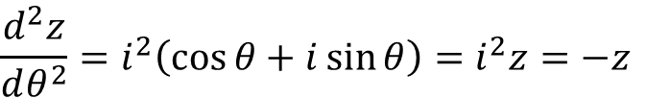

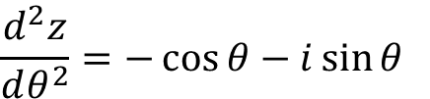
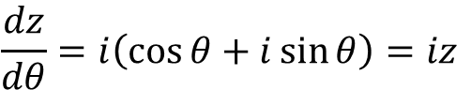
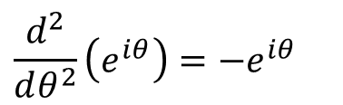
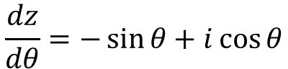
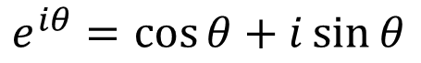
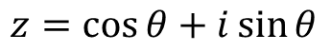
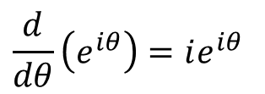
Euler’s Formula
$$z=\cos{θ}+i\sin{θ}$$
$$\frac{d}{dθ}\left(e^{iθ}\right)=ie^{iθ}$$
1
$$\frac{d^{2}}{dθ^{2}}\left(e^{iθ}\right)=−e^{iθ}$$
$$θ$$
$$e^{iθ}=\cos{θ}+i\sin{θ}$$
$$\frac{dz}{dθ}=−\sin{θ+i\cos{θ}}$$
$$\frac{d^{2}z}{dθ^{2}}=−\cos{θ−i\sin{θ}}$$
$$\frac{dz}{dθ}=i\left(\cos{θ}+i\sin{θ}\right)=iz$$
$$\frac{d^{2}z}{dθ^{2}}=i^{2}\left(\cos{θ}+i\sin{θ}\right)=i^{2}z=−z$$

Slide 26


Euler’s Formula
The difference between $e^{x}$ and $e^{ix}$

Slide 27
Euler’s Formula
The difference between $e^{x}$ and $e^{ix}$
Complex exponentials wave!

Slide 28



Open euler_formula.py
①
②
③

Slide 29

View euler_formula.py
①
②
③
④
⑤
⑥

Slide 30

View euler_formula.py
①
②
③
④
⑤
⑥

Slide 31

Run euler_formula.py
①
③
②
④

Slide 32














Euler’s Formula
$$e^{iθ}=\cos{θ}+i\sin{θ}$$
$$e^{iθ}=\cos{θ}+i\sin{θ}$$
$$+$$
$$−$$
$$e^{−iθ}=\cos{θ}−i\sin{θ}$$
$$e^{−iθ}=\cos{θ}−i\sin{θ}$$
$$e^{iθ}+e^{−iθ}=2cos{θ}$$
$$e^{iθ}−e^{−iθ}=2i\sin{θ}$$
$$\cos{θ}=\frac{e^{iθ}+e^{−iθ}}{2}$$
$$\sin{θ}=\frac{e^{iθ}−e^{−iθ}}{2i}$$
$$\sin{0}=0$$
$$\cos{0=1}$$

Slide 33
$$\sqrt{i}+\sqrt{−i}= ?$$
$$e^{iθ}=\cos{θ+i\sin{θ}}$$
$$\left(\cos{\frac{π}{4}+i\sin{\frac{π}{4}}}\right)+\left(\cos{\frac{−π}{4}+i\sin{\frac{−π}{4}}}\right)$$
$$e^{\frac{π}{2}i}=i$$
$$e^{\frac{−π}{2}i}=−i$$
$$\left(\frac{1}{\sqrt{2}}+\frac{i}{\sqrt{2}}\right)+\left(\frac{1}{\sqrt{2}}+\frac{−i}{\sqrt{2}}\right)$$
$$\sqrt{e^{\frac{π}{2}i}}+\sqrt{e^{\frac{−π}{2}i}}$$
$$\frac{1}{\sqrt{2}}+\frac{1}{\sqrt{2}}=\frac{2}{\sqrt{2}}=\sqrt{2}$$
$${\left(e^{\frac{π}{2}i}\right)}^{\frac{1}{2}}+{\left(e^{\frac{−π}{2}i}\right)}^{\frac{1}{2}}$$
$$\sqrt{i}+\sqrt{−i}=\sqrt{2}$$
$e^{\frac{π}{4}i}+$ $e^{\frac{−π}{4}i}$

Slide 34

Functional Equations
Consider the following series:
$$M_{n}\left(x\right)=1+x+x^{2}+x^{3}+…+x^{n}=\sum_{k=0}^{n}{x^{k}}$$
For example:$M_{2}\left(x\right)=1+x+x^{2}$
As $n→∞$ such that $M\left(x\right)=\sum_{k=0}^{∞}{x^{k}}$, what is the domain interval where $M(x)$ converges?
$M\left(1\right)=1+1+1+1+…=∞$ (diverges)
$M\left(0\right)=1+0+0+0+…=1$ (converges)
What about $M\left(−1\right)?$

Slide 35

Functional Equations
$$M\left(−1\right)=1+\left(−1\right)+{\left(−1\right)}^{2}+{\left(−1\right)}^{3}+{\left(−1\right)}^{4}+…=?$$
$$M_{5}(−1)=(1−1)+(1−1)+(1−1)=0$$
$$M_{6}(−1)=\left(1−1\right)+\left(1−1\right)+\left(1−1\right)+1=1$$
$$μ=\frac{(M_{5}+M_{6})}{2}=\frac{(0+1)}{2}=\frac{1}{2}∴M\left(−1\right)=0.5 ?$$
Note: This approach of adding partial terms of a series is called Cesàro summation

Slide 36


Functional Equations
$$M_{2}\left(x\right)\left(1−x\right)=\left(1\right)\left(1−x\right)+\left(x\right)\left(1−x\right)+\left(x^{2}\right)\left(1−x\right)$$
$$M_{2}\left(x\right)\left(1−x\right)=1−x+x−x^{2}+x^{2}−x^{3}$$
$$M_{2}\left(x\right)\left(1−x\right)=1+\left(−x+x\right)+(−x^{2}+x^{2})−x^{3}$$
$$M_{2}\left(x\right)\left(1−x\right)=1−x^{3}$$
$$M_{2}\left(x\right)=\frac{1−x^{3}}{1−x}∴M\left(x\right)=\frac{1−x^{∞}}{1−x}=\frac{1−0}{1−x}\left\{x∈ℝ (−1,1)\right\}$$
$$\lim_{n→∞}{x^{n}=0⇔\left|x\right|<1}$$

Slide 37

Functional Equations
$$M\left(x\right)=\frac{1−x^{∞}}{1−x}=\frac{1}{1−x}⟺−1<x<1$$
$M\left(−1\right)=\frac{1}{1−(−1)}=\frac{1}{2}$ ?! (debatable as ${−1}^{∞}$ is undefined)
$$M\left(x\right)=1+x+x^{2}+…=\sum_{k=0}^{∞}{x^{k}}=\frac{1}{1−x} \left\{x∈ℝ (−1,1)\right\}$$
$M\left(x\right)=\frac{1}{1−x}$ is the functional equation for the infinite series only over the exclusive domain (-1, 1)
We no longer need to add an infinite number of terms to get the sum within that domain – we can use this limit as a shortcut!

Slide 38
A Functional Equation for the Factorial
Consider the classic factorial function:
$$n!=n∗\left(n−1\right)∗\left(n−2\right)∗\left(n−3\right)∗…∗1$$
$$5!=5 ∗4 ∗3 ∗2 ∗1=120$$
We wish to find a functional equation that provides a shortcut to compute the factorial without having to iterate through the product of every term
A closed form (analytic) Riemann Integral is the functional equation of an infinite series of diminishing rectangles under a curve within a given interval
Can we express the factorial function as an integral?

Slide 39
Euler’s Gamma Function
$$n!=Γ\left(n+1\right)$$
$$5!=Γ\left(6\right)=120$$
$$Γ\left(s\right)=\int_{0}^{∞}{x^{s−1}e^{−x}ⅆx} \left\{s∈ℂ, Re\left(s\right)>0\right\}$$
$$Γ\left(6\right)=\int_{0}^{∞}{x^{5}e^{−x}ⅆx}= ?$$

Slide 40
Euler’s Gamma Function
$$Γ\left(6\right)=\int_{0}^{∞}{x^{5}e^{−x}ⅆx}$$
Recall integration by parts (from differential product rule)
$$\int{uⅆv=uv−\int{v}ⅆu}$$
$$u=x^{5},ⅆv=e^{−x}ⅆx$$
$$du={5x}^{4}dx,v={−e}^{−x}$$
$${\left.\left(x^{5}\right)\left({−e}^{−x}\right)\right|}_{0}^{∞}−\int_{0}^{∞}{({−e}^{−x}){(5x}^{4}dx)}$$

Slide 41
Euler’s Gamma Function
$${\left.\left(x^{5}\right)\left({−e}^{−x}\right)\right|}_{0}^{∞}−\int_{0}^{∞}{({−e}^{−x}){(5x}^{4}dx)}$$
$$\lim_{b→∞}{(b^{5})\left(−e^{−b}\right)}−\left(0^{5}\right)\left(−e^{−0}\right)=\lim_{b→∞}{\frac{b^{5}}{−e^{b}}=0}$$
$$−\int_{0}^{∞}{({−e}^{−x}){(5x}^{4}dx)}=5\int_{0}^{∞}{x^{4}e^{−x} dx}$$
$$Γ\left(6\right)=5\int_{0}^{∞}{x^{4}e^{−x} dx}= ?$$
$$Γ\left(6\right)=\int_{0}^{∞}{x^{5}e^{−x}ⅆx}$$

Slide 42
Euler’s Gamma Function
$$Γ\left(6\right)=5\int_{0}^{∞}{x^{4}e^{−x} dx}$$
$$Γ\left(6\right)=20\int_{0}^{∞}{x^{3}e^{−x} dx}$$
$$Γ\left(6\right)=60\int_{0}^{∞}{x^{2}e^{−x} dx}$$
$$Γ\left(6\right)=120\int_{0}^{∞}{x^{1}e^{−x} dx}$$
$$Γ\left(6\right)=120\int_{0}^{∞}{{x^{0}e}^{−x} dx}=(120)(1)$$
$$Γ\left(6\right)=120=5!$$

Slide 43
Euler’s Gamma Function
$$Γ\left(s\right)=\int_{0}^{∞}{x^{s−1}e^{−x}ⅆx} \left\{s∈ℂ, Re\left(s\right)>0\right\}$$
Realize the real Gamma function is just an integral that we can numerically compute using Simpson’s Rule
Let’s plot this integral over the domain of real numbers
We will first plot $Γ(s)$ from $0≤s≤5$ along with $y=s!$

Slide 44



Open plot_euler_gamma.py
Imperative
Procedural
Declarative
Functional
①
②
③
④

Slide 45



Open plot_euler_gamma.py
$$Γ\left(s\right)=\int_{0}^{∞}{x^{s−1}e^{−x}ⅆx}$$
$$s=0, x=0⟹ ??$$
③
④
②
①

Slide 46

View plot_euler_gamma.py
①
②
③
④
⑤

Slide 47

Run plot_euler_gamma.py
$$5!=Γ\left(6\right)=120$$
$$4!=Γ\left(5\right)=24$$
$$3!=Γ\left(4\right)=6$$

Slide 48

Edit plot_euler_gamma.py
Uncomment lines 55-56
①
②

Slide 49


Run plot_euler_gamma.py
$$2!=Γ\left(3\right)=2$$
$$1!=Γ\left(2\right)=1$$
$$\frac{1}{2}!=Γ\left(1.5\right)=\frac{\sqrt{π}}{2}$$

Slide 50

Euler’s Gamma Function
Euler was a mathematical pathfinder – he liked to bend the rules and push the boundaries of existing functions
He asked, “what is the factorial of a fraction?”
He also asked, “what is the factorial of a negative number?”
We can clearly see in the plot that $\left(\frac{1}{2}\right)!<1$
But Euler went farther and proved these two gems:
$$\left(\frac{1}{2}\right)!=\frac{\sqrt{π}}{2}=0.8862269…$$
$$\left(−\frac{1}{2}\right)!=\sqrt{π}=1.7724538…$$

Slide 51



①

Slide 52

Now you know…
Only the set of complex numbers $ℂ$ is closed under both division and radicals
$$\frac{1}{2}∉ℤ, \sqrt{2}∉ℚ, \sqrt{−1}∉ℝ$$
The numerators in the Taylor series for $e^{x}$ can be complex numbers
Euler’s Identity shows a deep relationship between the five most important constants in all of Mathematics!
Analytic continuation can be used to extend the factorial function to include both the Real and Complex domains
The matplotlib.pyplot functions allow you to save a plot as image (JPG, PNG, etc.) and as an Adobe PDF which is great when making science posters

Slide 53

Now you know…
Napier’s logarithm down converts multiplication into easier addition:
$$\log{AN=\log{A}+\log{B}}$$
De Moivre’s Formula down converts exponentiation into easier multiplication:
$${\left(\cos{θ+i\sin{θ}}\right)}^{n}=\cos{nθ+i\sin{nθ}}$$
Euler’s Formula is considered the most useful equation in all of mathematics!
$$e^{iθ}=\cos{θ+i\sin{θ}}$$
Euler's Formula is a crucial element of Fourier Analysis, and hence a foundational concept in Quantum Mechanics

Slide 54
Now you know…
Functional equations essentially summarize the behavior of an infinite series
They provide a shortcut to determine the converged limit without having to loop through every element
They often allow you to extend the domain of the series to evaluate points that at first seem impossible
What is means for two algebraically different functions to be the same is a tricky question – especially when you are only interested in certain points along the domain!
It is interesting to break the rules and insert unexpected values into existing formulas to see what happens – be a mathematical renegade!

